Slide 1
Processing of 16S rRNA
Amplicon-Sequencing Data
Germán Bonilla-Rosso
Garance Sarton
SAGE February 2021

Slide 2
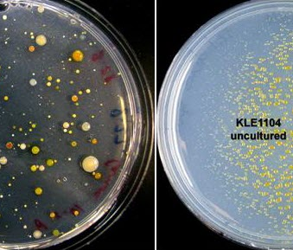
Studying Bacteria...
The Great
Plate Count Anomaly
How do we study organisms that...
- are morphologically indistinguishable?
- are phenotypically redundant?
- are unculturable?
- are uncountable?
- have no clear species boundaries?
wildlife
domesticated
(E. coli)
Notes:
To describe the difference in order of magnitude between the number of cells from natural environments that form colonies on agar plates and the number countable by microscopic examination

Slide 3
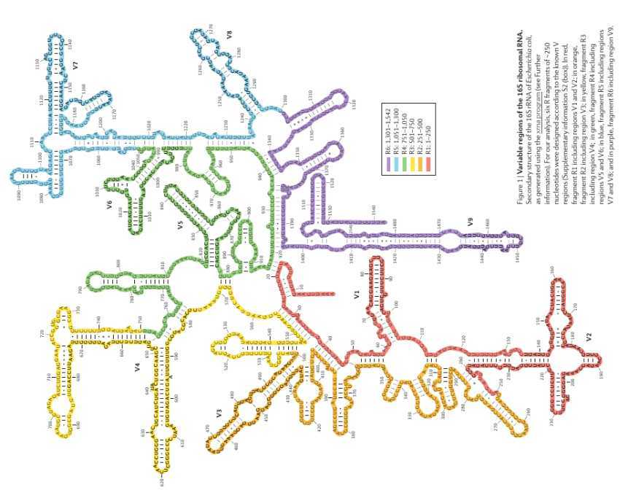
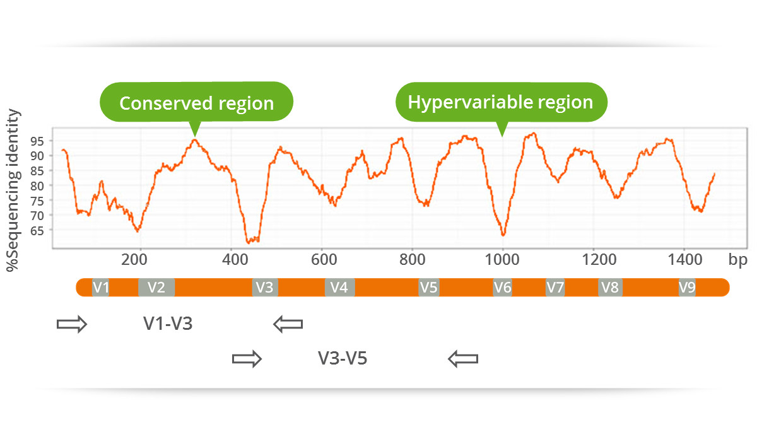
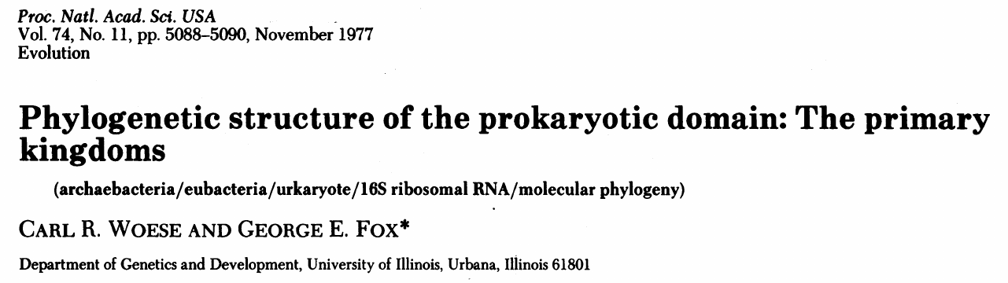
Classifying Domesticated Bacteria...
Use of 16S rRNA sequences to classify bacteria and determine its phylogenetic relationships
We need :
Universally conserved (present in all organisms)
Overall low mutation rate allows comparison of lineages that diverged long ago...
… but with “faster” evolving regions that allow inspection of more recent differences!
Notes:
This paper emphasize on the necessity to have a molecule of a broad distribution to determine the relationshi of the entire spectrum of the living systems. 1977, description and suggestion of a new group, the archaea

Slide 4
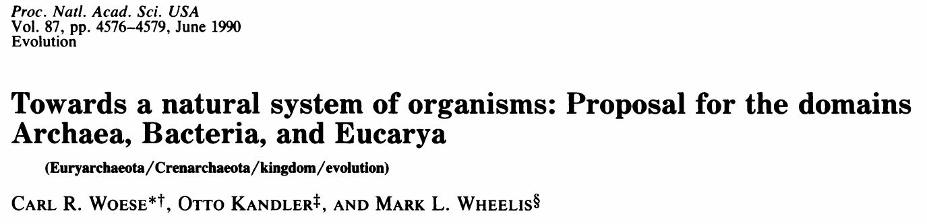
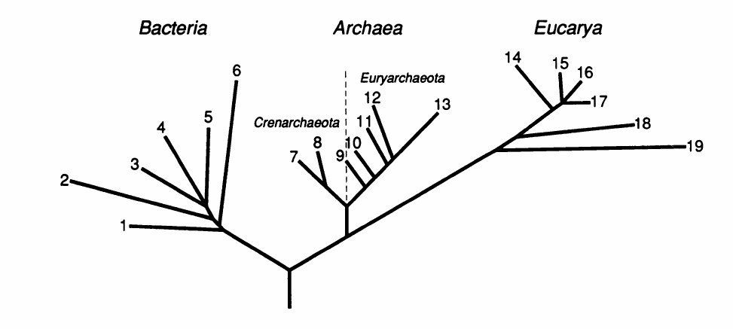
Classifying Domesticated Bacteria...
The Three Domains of Life
Notes:
Period of the five kindomms (Animalia, plantae, Fungi, Protista and Monera –prokaryotes) . They suggested a new level of classification as it was clear for them that a division of life has happened to split the bacteria and the eukaryotes and the animal/plants is secondary divisaion. Above the kingdom, exists a new taxon called domain – Bacteria, Archaea and the Eucarya

Slide 5
Studying Undomesticated Bacteria...
How do we study organisms that...
- are morphologically indistinguishable?
- are phenotypically redundant?
- are unculturable?
- are uncountable?
- have no clear species boundaries?
By sequence phylogenetic analysis of 16SrRNA

Slide 6
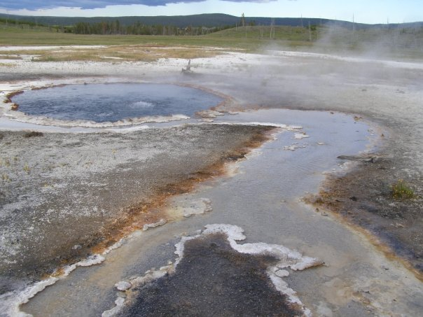


Classifying undomesticated Bacteria...
pink filamentous bacteria from Octopus Spring, Yellowstone
Skip culturing and characterizing,
direct DNA extraction and sequencing of rRNA
(Norman Pace & David Stahl, 1981)
...before PCR!!!
Notes:
Sequenced the 5S, the
86-88 first PCR

Slide 7
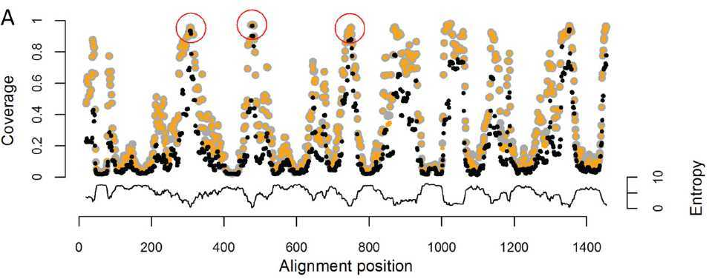
Dissection of 16S rRNA
Design primers in the conserved regions...
… and amplify the variable regions!

Slide 8
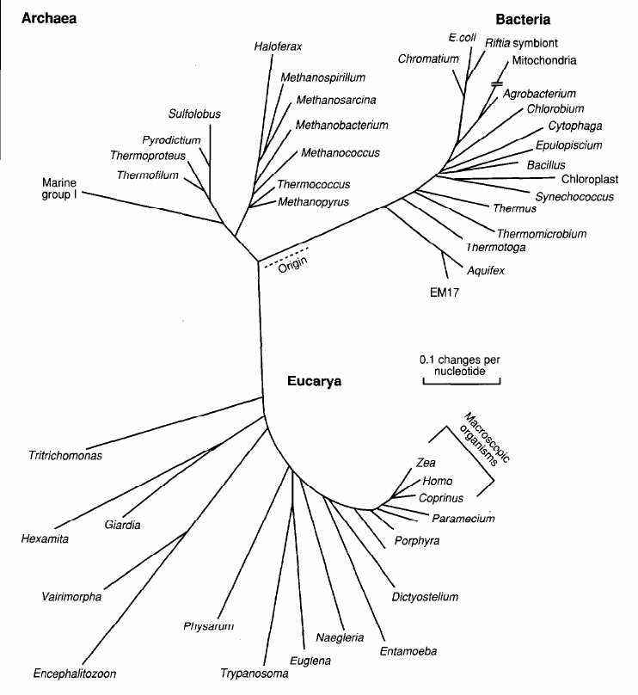
Classifying undomesticated Bacteria...
Sequencing of 16S rRNA from environmental DNA led to an explosion of discovery of novel bacterial and archaeal lineages... in individual samples!
Notes:
Some samples are only characterised by their 16S.

Slide 9
Studying Undomesticated Bacteria...
By sequence and phylogenetic analysis of 16SrRNA from isolates
How do we study organisms that...
- are morphologically indistinguishable?
- are phenotypically redundant?
- are unculturable?
- are uncountable?
- have no clear species boundaries?
By sequence and phylogenetic analysis of 16SrRNA from environmental samples
Notes:
Now the last question, how do we study organisms that have no clear species boundaries ?

Slide 10

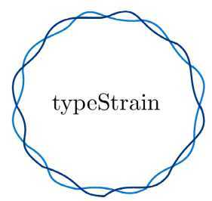
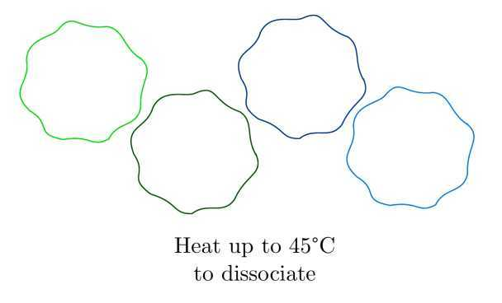
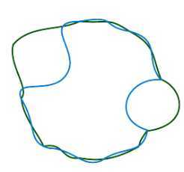
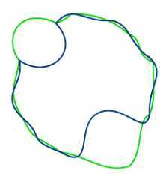
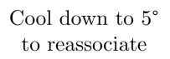
Determining if two strains are the same, 70's style…
DNA-DNA hybridization test...
>70% reassociation AND stable at 5 C
is the same species
>80% reassociation
is the same subspecies
Notes:
After reassociation, the % of reassociation is measured by the melting profile of the hydridized DNA -> DNA is heated step by step, wash the column at each step and melted sequences are single stranded and wash of the column. The temperature of wash off reflects the amount of similarity (the higher the similarity the greater amount of energy you need).

Slide 11
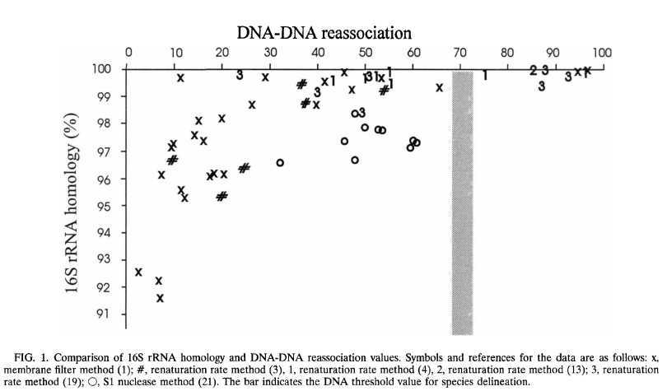
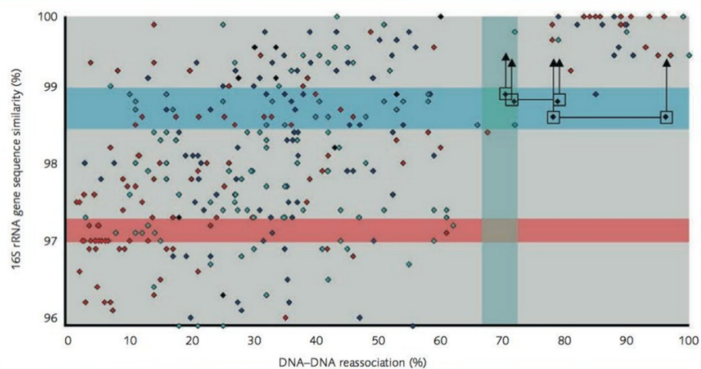
The 97% “Golden Standard”
red: microtitre plate technique
dark blue: spectrophotometric technique
light-blue: membrane filter method
black: other
“...below a threshold value of 98.5% sequence similarity, the corresponding DNA reassociation values were always lower than 70%.”
“... reassociation experiments need only be performed for strains that shared 16S rRNA gene sequence similarities higher than 98.7-99%”.
“... rare examples may exist […] in which reassociation values >70% emerge at corresponding 16SrRNA similarities ~99%”.
[Stackebrandt & Goebel 1994]
“One can nevertheless argue that organisms which have >70% DNA similarity will have at least 97% sequence identity.”
“...at sequence homology values below 97.5%, it is unlikely that two organisms have more than 60 to 70% DNA similarity and hence that they are related at species level.”
[Stackebrandt 2006]
[Stackebrandt & Goebel 1994]
Notes:
How do you link the hybridization test and the similarity in the 16S ?
Arrows point to the position of in silico-recalculated binary 16S rRNA gene sequence similarity values of sequences deposited by Amakata et al. (2005)
The horizontal blue bar indicates the threshold range above which it is now recommended to perform DNA–DNA reassociaton exps

Slide 12
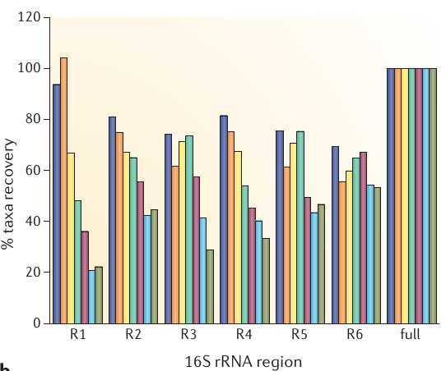
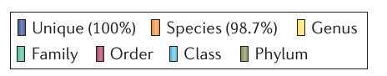
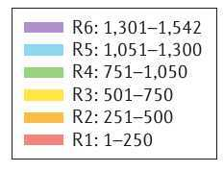
Limitations of 16S rRNA for taxonomic determination
Yarza et al. 2014
Notes:
Study which used all the available 16S sequences from the living tree project, 8600. They designed 6 fragments of – 250 nucleotides and analysed the accuracy of predicting taxonomic thresholds and richness estimates from partial sequences

Slide 13
Limitations of 16S rRNA for taxonomic determination
The 97-98.5% golden threshold is considering the FULL LENGTH...
if you amplify a fragment, you just have NOT ENOUGH resolution at species/subspecies level!!!!
Yarza et al. 2014

Slide 14
Studying Undomesticated Bacteria...
By sequence and phylogenetic analysis of 16SrRNA from isolates
How do we study organisms that...
- are morphologically indistinguishable?
- are phenotypically redundant?
- are unculturable?
- are uncountable?
- have no clear species boundaries?
By sequence and phylogenetic analysis of 16SrRNA from environmental samples
By sequence similarity of the FULL LENGTH of 16SrRNA

Slide 15
Amplicon-Sequencing

Slide 16
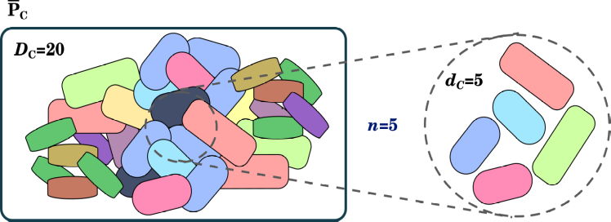
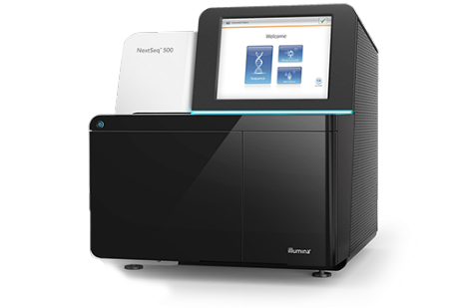

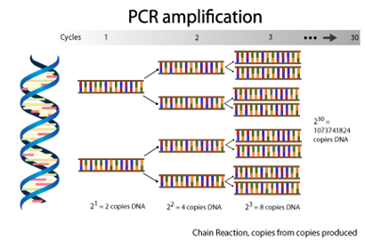

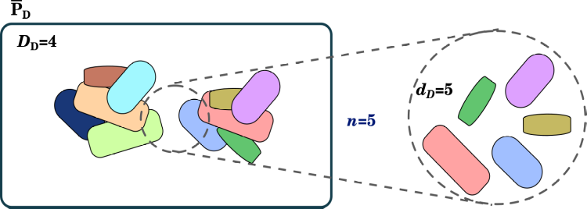
Microbiology tries Ecology!
counts

Slide 17
Amplicon Sequencing p1
341-5'
515-3'
genomic V3-V4 Region
F
PCR target
R
a1
F
16S amplicon
R
a2
tags / adapters
PCR amplification primer
5'-ACACTCTTTCCCTACACGACGCTCTTCCGATCT-NNNN-fwd_primer-3'
5'-AGACGTGTGCTCTTCCGATCT-rev_primer-3'
Notes:
The method is to use a two step PCR protocol, the first PCR step is used to amplify the region of interest with target specific primers.

Slide 18
Amplicon Sequencing p2
a1
F
16S amplicon
R
b2
P5
i1
a1
F
16S amplicon
R
b2
i2
P7
16S
16S amplicon
b2
b2
P7
P5
P7
P5
i1
i1
F
a1
F
a1
R
R
i2
i2
Barcodes/Indexes Read
Paired-End sequencing primer
tags / read primer site
Notes:
the universal sequences CS1 and CS2, which provide the bases used in. the second PCR to extend the amplicons with Illumina adapters and sample-identification barcodes.

Slide 19
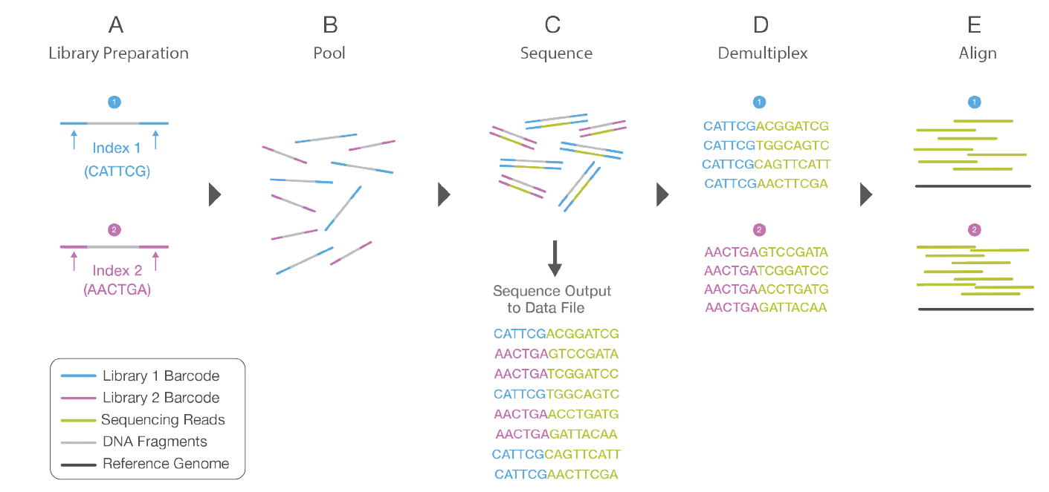
Amplicon Sequencing - Multiplexing
Notes:
To do multiplexing, 2 step PCR

Slide 20
Anatomy of an Illumina Read
Sequencing primer: allows you to identify paired-mate reads
Index: biological sample identifier, allows you to multiplex
Adapter: needed to tag all PCR products for barcoding/sequencing
Random Ns: to improve sequencing and clustering
UserPrimer: this is the primer you used for gene amplification
Amplicon: this is why you are doing all this!
P5
i1
a1
F
16S amplicon 5'
16S amplicon 3'
R
b2
i2
P7

Slide 21
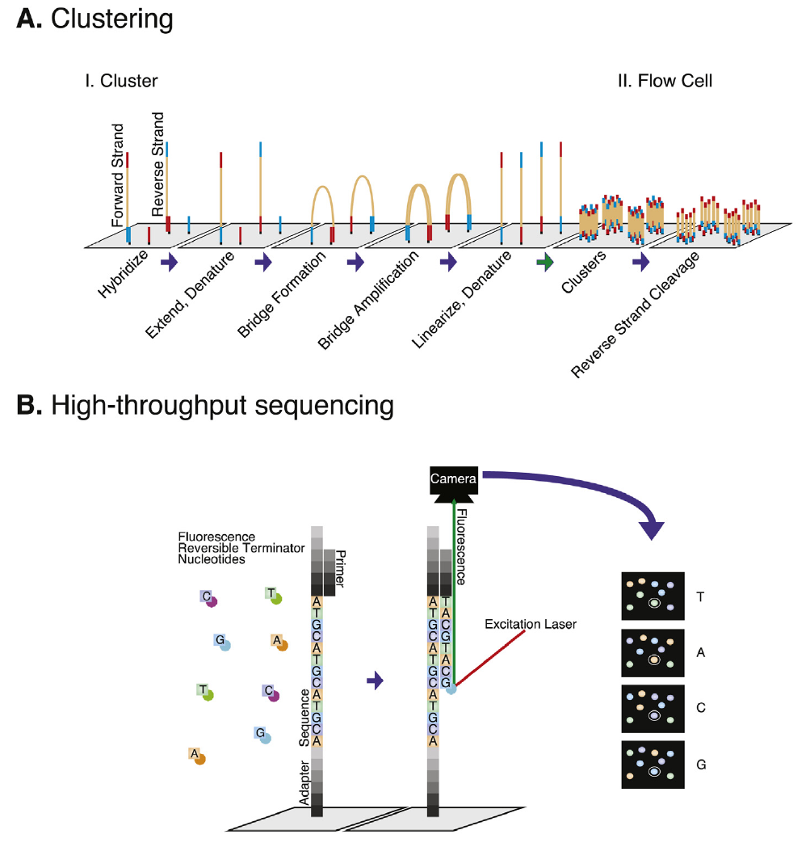
Illumina
Sequencing

Slide 22
Illumina Sequencing
P5
i1
a1
F
16S amplicon
R
b2
i2
P7
16S
16S amplicon
b2
b2
P7
P5
P7
P5
i1
i1
F
a1
F
a1
R
R
i2
i2
P5
i1
a1
F
16S amplicon 5'
16S amplicon 3'
R
b2
i2
P7
16S amplicon 3'
R
b2
i2
P7
P5
i1
a1
F
16S amplicon 5'

Slide 23
Post-Sequencing Preprocessing
(Demultiplexing and Trimming)
Sequencing primer: allows you to identify paired-mate reads
Index: biological sample identifier, allows you to multiplex
Adapter: needed to tag all PCR products for barcoding/sequencing
Random Ns: to improve sequencing and clustering
UserPrimer: this is the primer you used for gene amplification
P5
i1
a1
F
16S amplicon 5'
16S amplicon 3'
R
b2
i2
P7
often forgotten
taken away ONLY if sequence processing asked
often taken away by sequencing facility if reads are DEMULTIPLEXED

Slide 24
How do we correct sequencing errors?
How do we translate sequence reads to bacterial species?

Slide 25
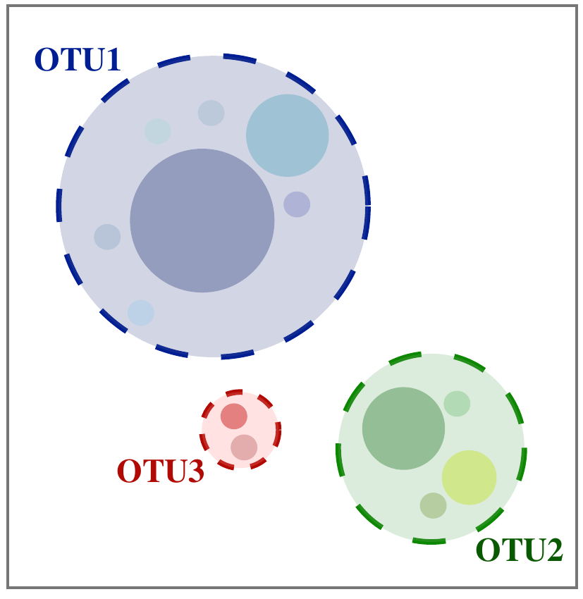
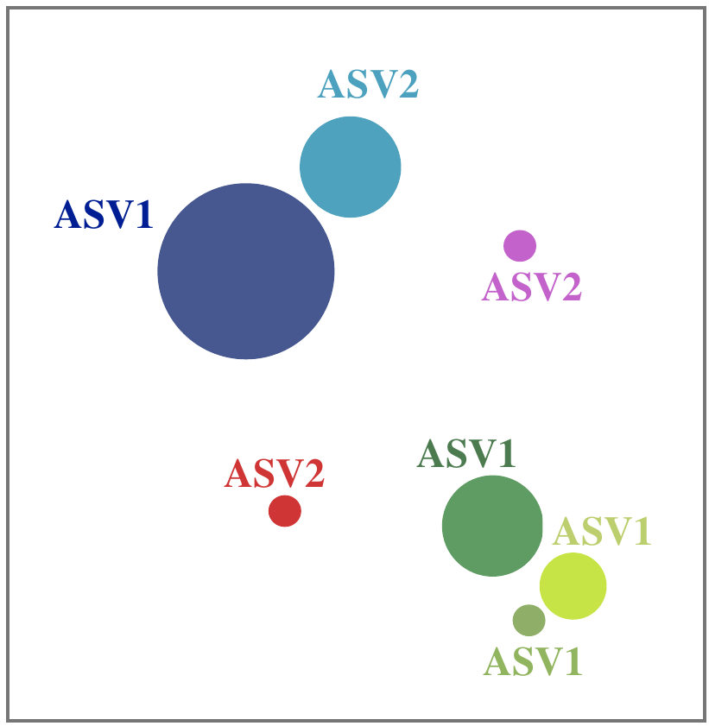
Strategies for Analysing Amplicon Sequences
Operational
Taxonomic Units
(OTUs)
Amplicon Sequence
Variants
(ASVs)

Slide 26
Clustering OTUs by % Identity

Slide 27
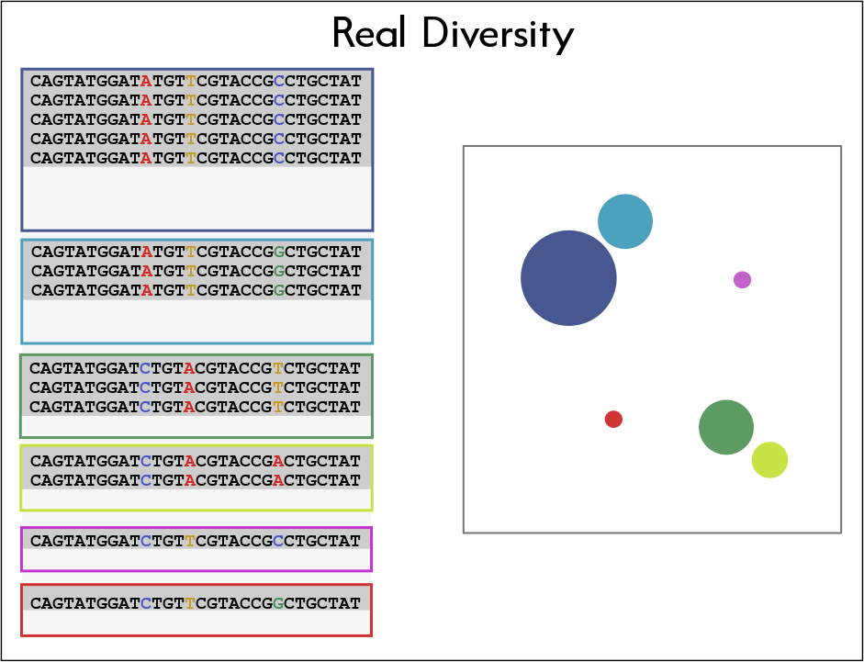

Slide 29
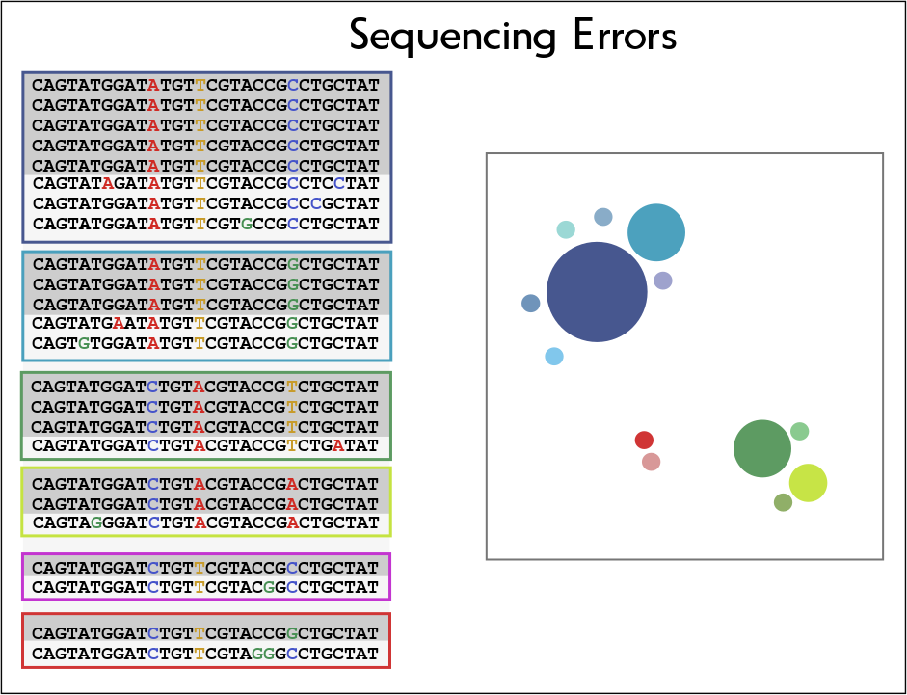

Slide 30
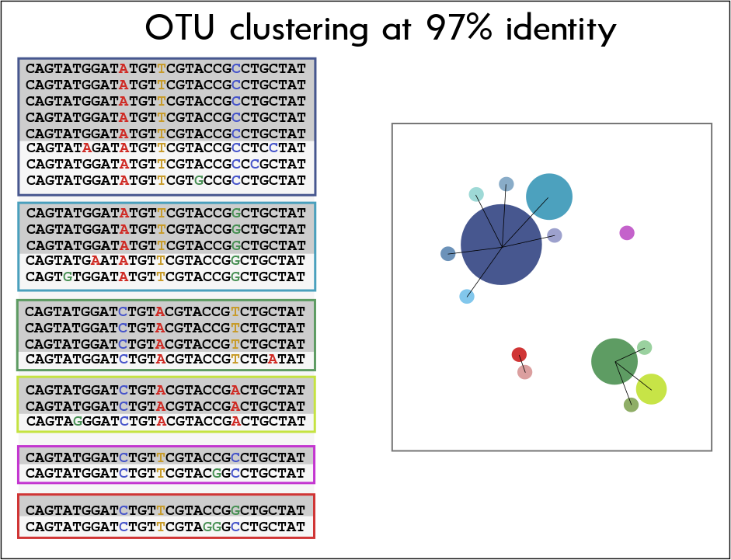

Slide 31
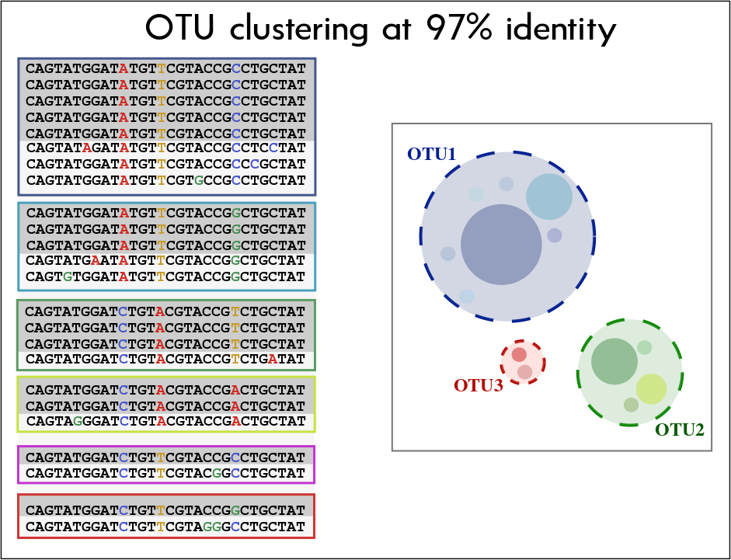

Slide 32
Problems with OTU Clustering
→ Arbitrary threshold:
The 97% identity threshold is not backed by any evolutionary or ecological theory
→ Low Resolution:
Short 16S fragments cannot resolve species/strains
→ Underestimation of Diversity:
At 97%, different strains are clustered into the same OTU
→ Inability to estimate singletons

Slide 33
Detecting Exact Amplicon Sequence Variants after Noise Reduction

Slide 35


Slide 36
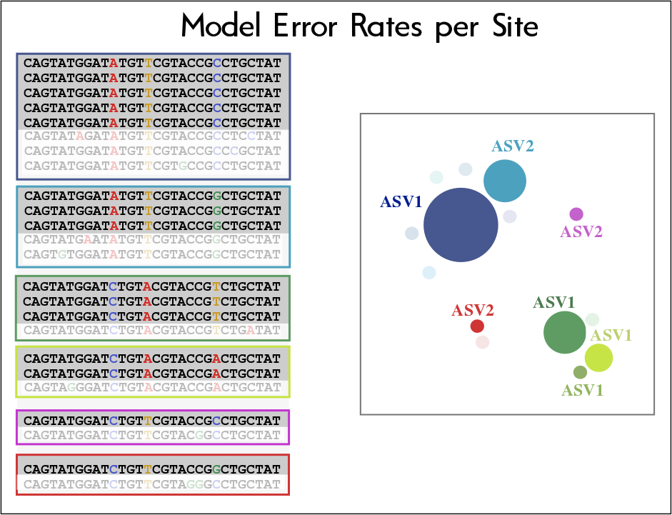

Slide 37
Divisive Amplicon Denoising Algorithm (DADA2)
Errors are independent events
- No correlation between errors, so errors occurring in different sequences and in the same sequence are independent of each other
Errors are dependent of the Q-score
- Each base-pair has an associated Q-score
Error transitions can be modeled
- Transitions depend on original base, substituting base and quality

Slide 38
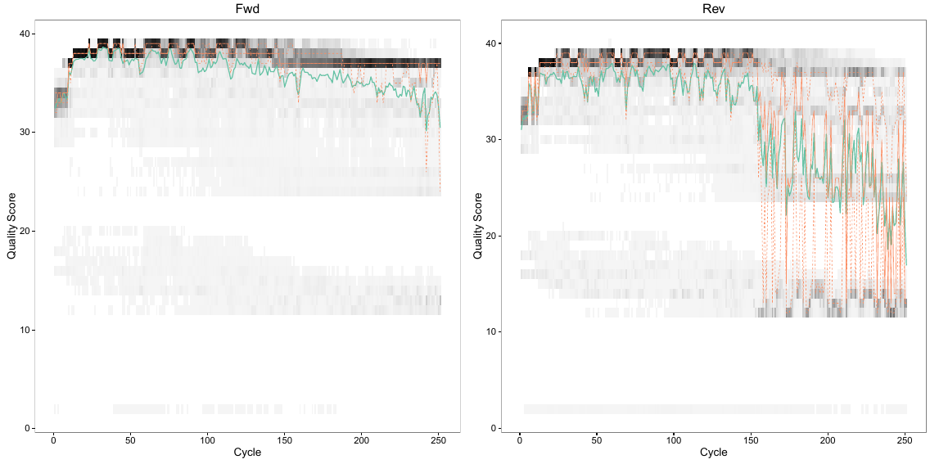
DADA2
Each read orientation has independent error profiles
More accurate models are generated with larger amount of data... but really bad quality reads reduce model accuracy

Slide 39
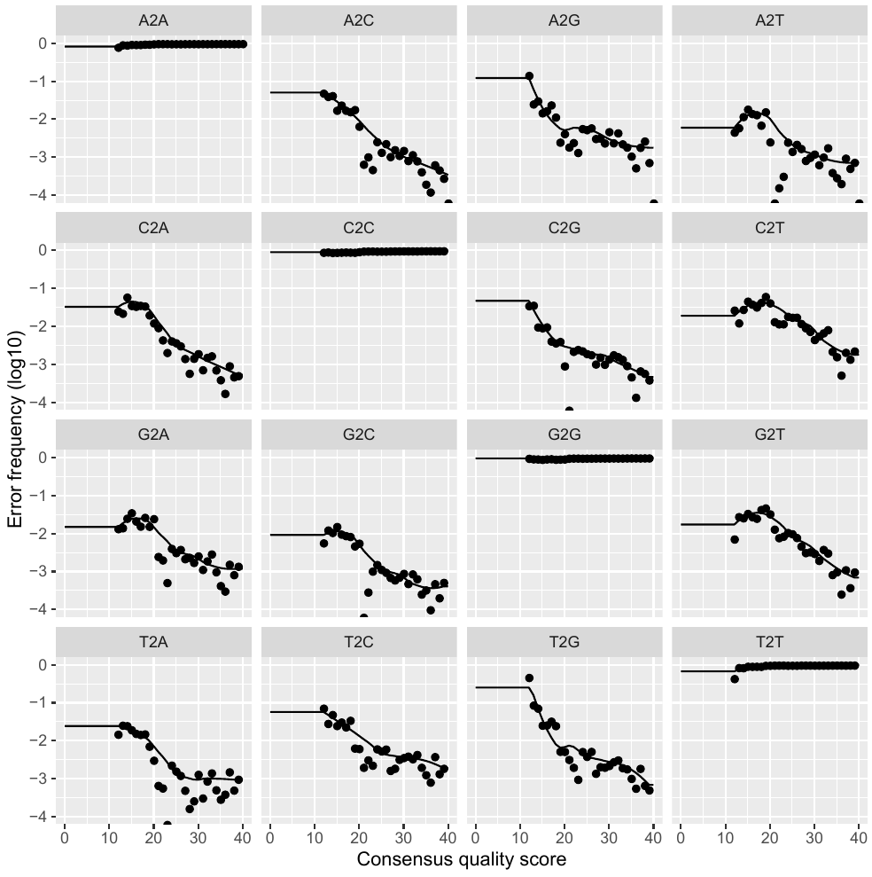
DADA2
Error rates are learnt (modeled) as a function of sequencing quality...

Slide 40
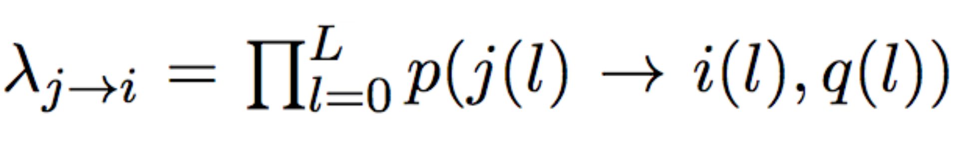
DADA2
What are the chances of generating a sequence with error?
The probability of generating a sequence i with an error from real sequence j equals the product of per-site probability of transition.
The transition probability depends on
- the original base,
- the substituting base,
- the quality score
Notes:
L = number of aligned nucleotides

Slide 41
DADA2
If errors are independent between reads, and error-containing reads originate from real reads... we can model their expected abundances
- Error reads will always be less abundant than real reads!
- The expected abundance of an error-containing sequence i follows a Poisson distribution and is equal to the error rate (previous slide) multiplied by the expected reads of sample sequence j.
- We can calculate a p-value, or the probability of seeing an error-containing sequence i with an abundance equal to or greater than the observed value by chance, given the abundance of parent sequence j.
→ A low pA(j→i) means the abundance of sequence i cannot be explained by errors during amplification and sequencing of n_{j} copies
Notes:
The

Slide 42
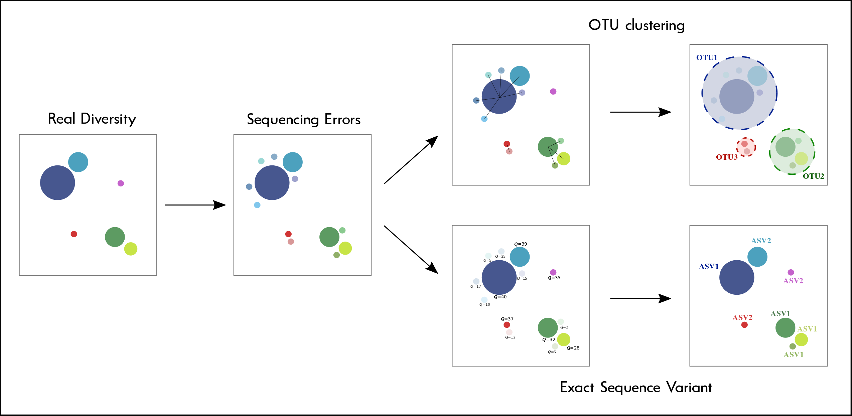
Strategies for Analysing Amplicon Sequences

Slide 43
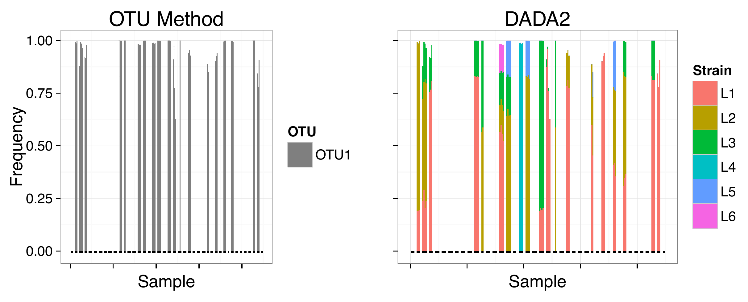
ASVs have much finer resolution
Where OTUs only see one Lactobacillus vaginalis, DADA2 sees six different strains!

Slide 44
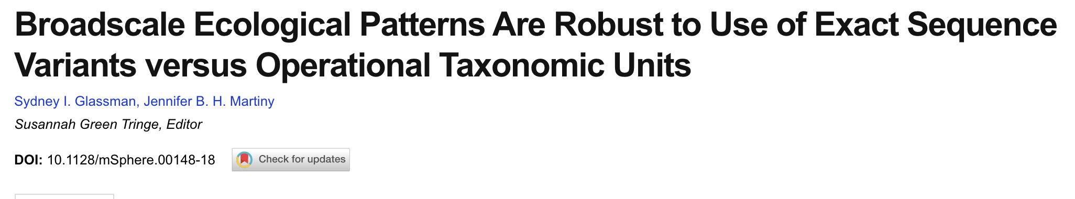
Problems with ASVs…
-> Most bacteria have multiple 16SrRNA copies that diverge in one SNP. This will be recognized as different ASVs, inflating the diversity and considering multiple copies as different strains. This does not occur with OUT clustering.
-> It is dependent on data quality. Since it is a probabilistic approach, very low-quality datasets will overestimate ”real” SNPs. Fortunately, most datasets come today with very high Q.
-> For ecological studies, the broad ecological patterns observed with OTUs have been shown to be the same as with ASVs:

Slide 45
Problems with ASVs…
-> Datasets processed in different runs will only be comparable if they were run exactly the same (including filtering steps). An open question is whether it is fair to compare ASV profiles generated from datasets with different quality.
-> The fact that ASVs are precise and high-quality unique sequences does not mean they are relevant. Standing variability in a population is often neutral and not fixed, and thus irrelevant for ecological and evolutionary studies.
-> The large number of unique sequences produced may obfuscate differential patterns observed at higher taxonomic levels. Since analyses at these levels should involve clustering, the benefit of using ASVs despite clustering later is put in question.

Slide 46
Final considerations
-> Neither OTUs not ASVs represent natural biological units, and they are just operational. You can argue that ASVs are “real” sequences and will be right, but knowing what that actually means in terms of bacterial cells or species is not straightforward.
-> The 16SrRNA fragment amplicons cannot delineate bacterial species
-> The 16SrRNA cannot inform on bacterial phenotypes
-> You should always have a clear question that you want to answer with your analysis, and never stretch the limits of your technology and analyses.

Slide 47
PHYLOSEQ

Slide 48
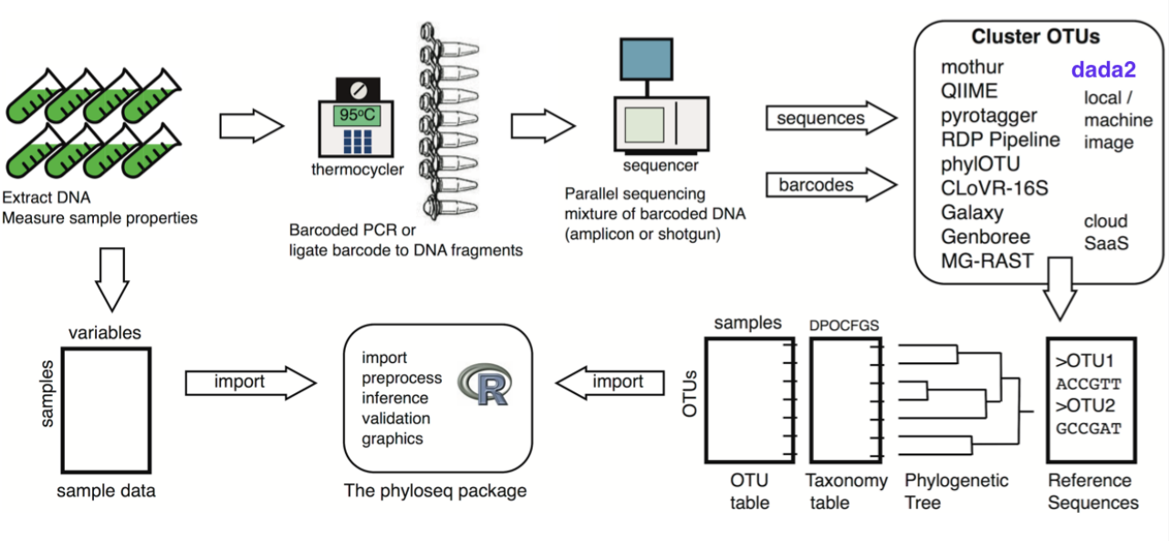
PHYLOSEQ

Slide 49
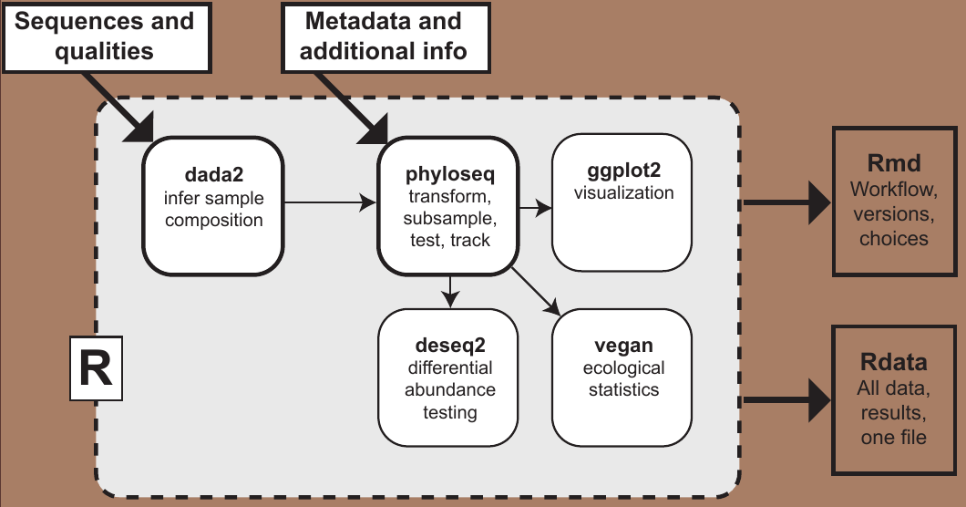
PHYLOSEQ

Slide 50
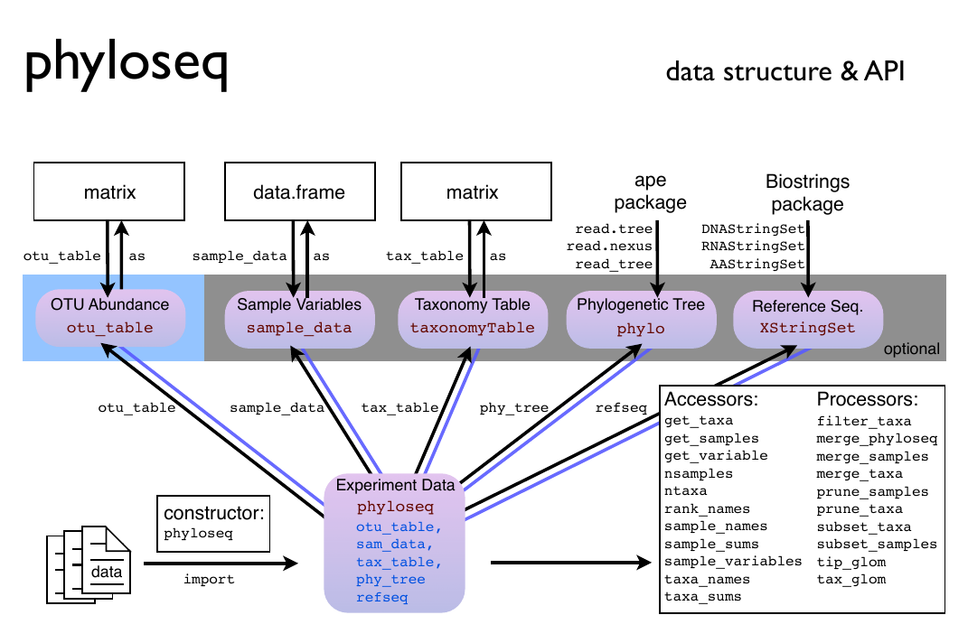
PHYLOSEQ

Slide 51
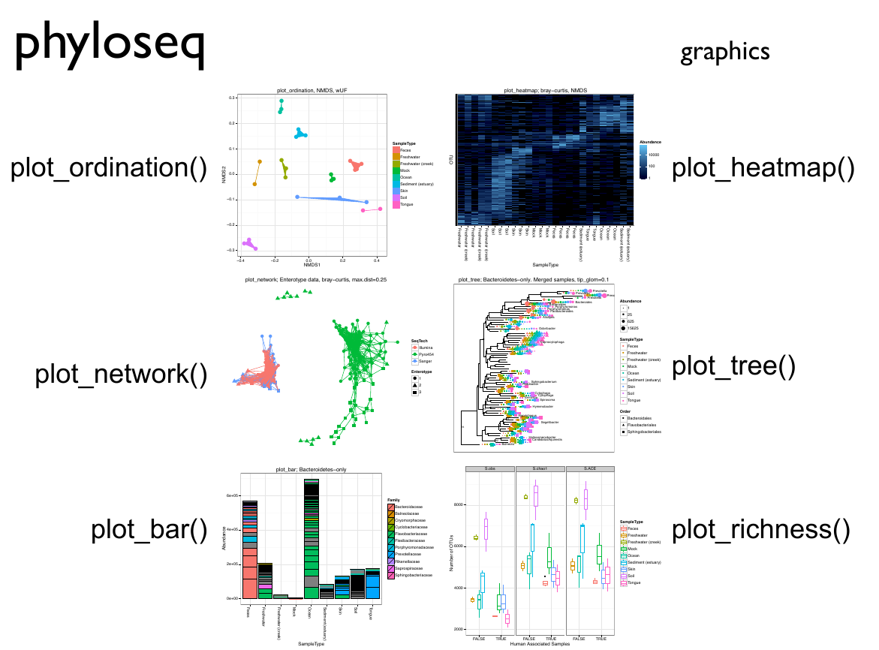
PHYLOSEQ

